Slide 1
Deep Learning Era
Sameer mahajan

Slide 2
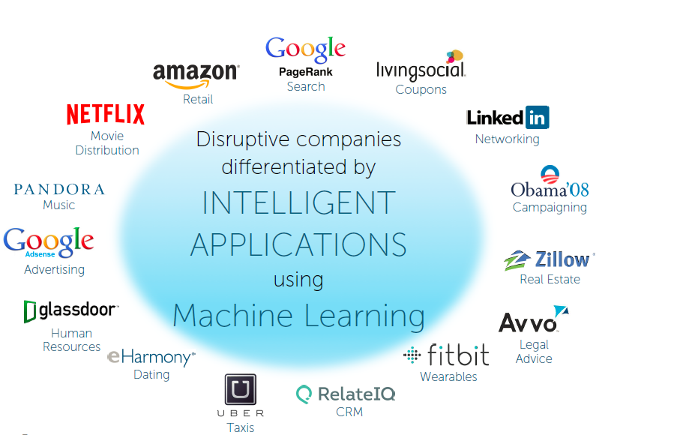

Slide 3
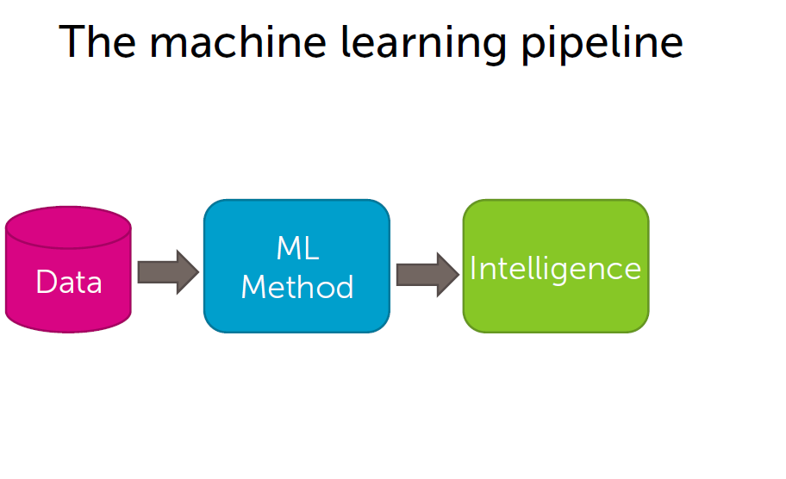
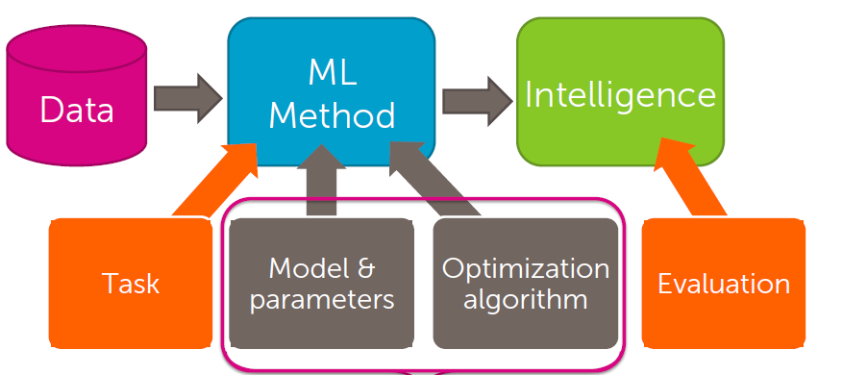

Slide 4
Types of problems and solutions
Regression: real valued output, predicting house prices
Classification: product reviews
Clustering: unsupervised learning, document retrieval
Recommender systems: product recommendation
Deep learning: neural networks

Slide 5
Introduction
Jupyter notebook
Python
Numpy
Pandas
Matplotlib
Scikit learn

Slide 6
Commands to remember
sudo docker run -it -p 8888:8888 gcr.io/tensorflow/tensorflow (to run the preinstalled container)
http://localhost:8888/?token=<token id> (to connect to jupyter notebook)
sudo docker ps (to get container id of running container)
sudo docker exec -it <container id> bash (to enter the container)

Slide 7
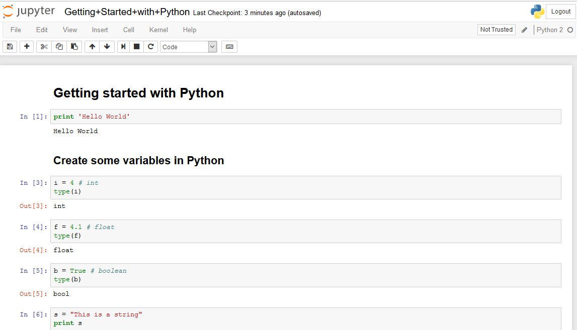

Slide 8
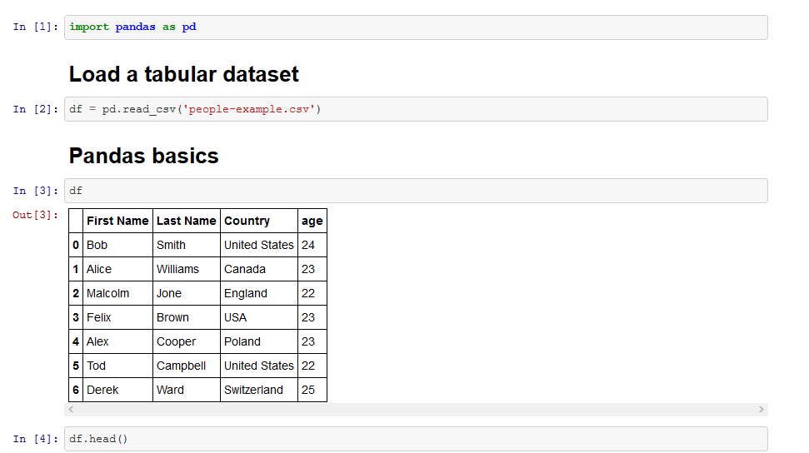

Slide 9
Regression
Predicting house prices
Linear regression

Slide 10
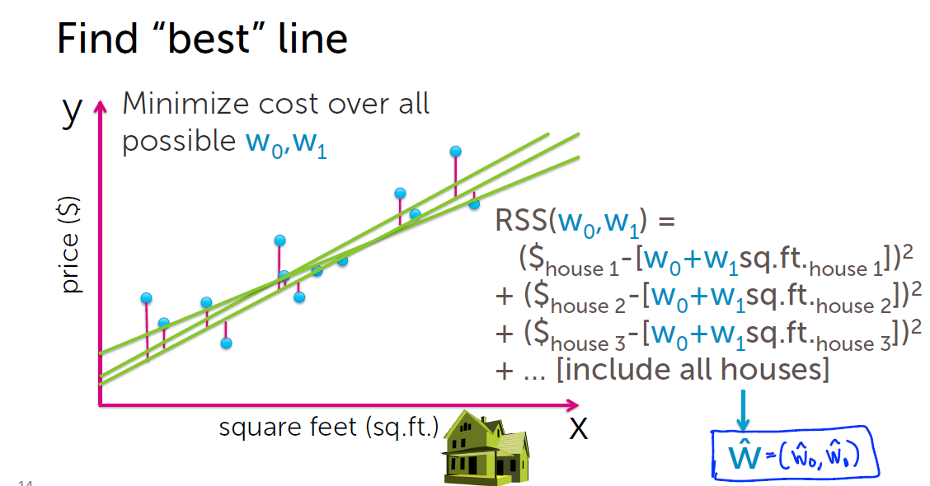

Slide 11
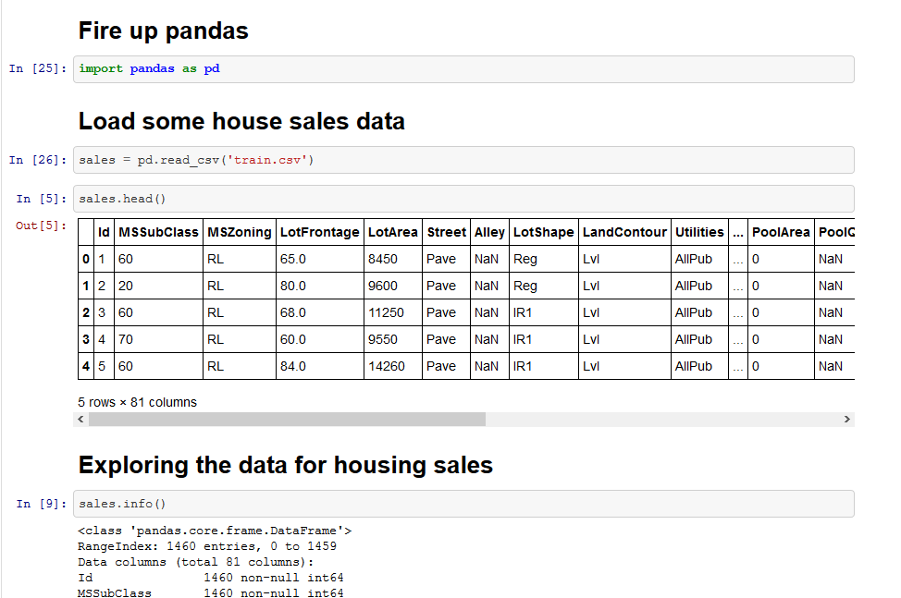

Slide 12
Classification
Sentiment analysis
Analyze restaurant reviews

Slide 13
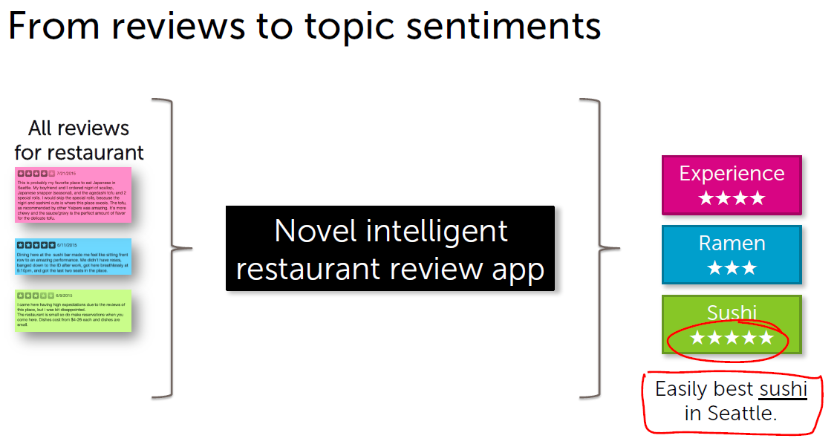

Slide 14
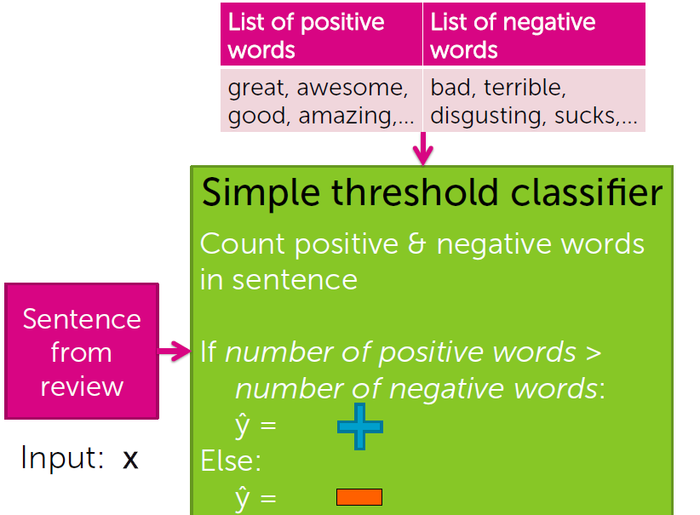

Slide 15
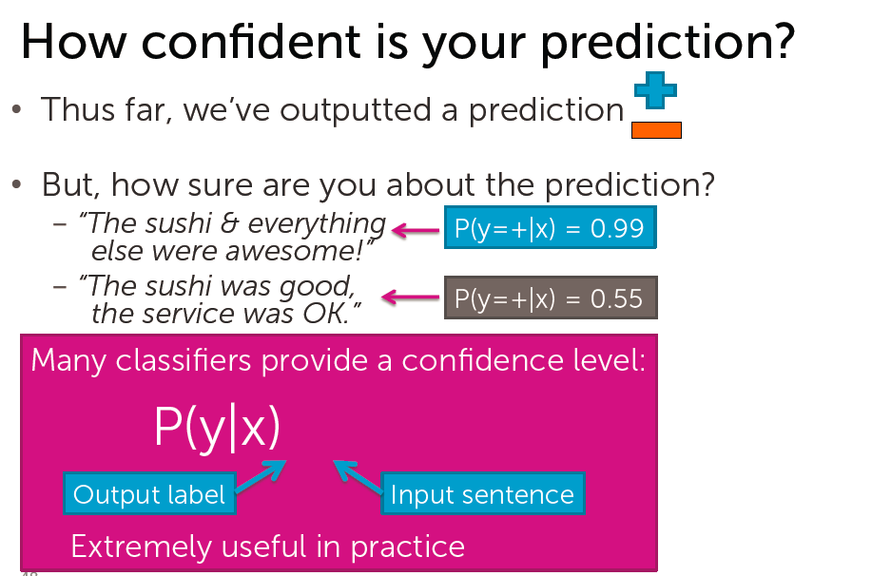

Slide 16
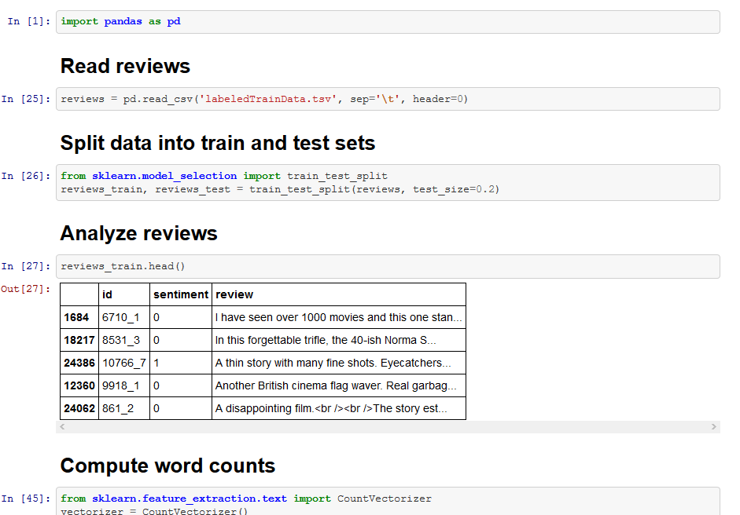

Slide 17
Clustering
Unsupervised learning
Document retrieval

Slide 18
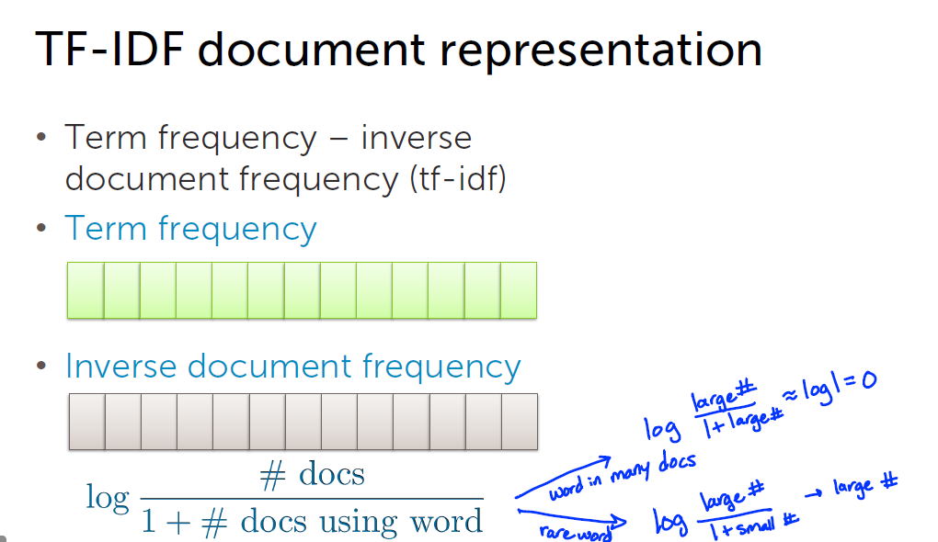

Slide 19
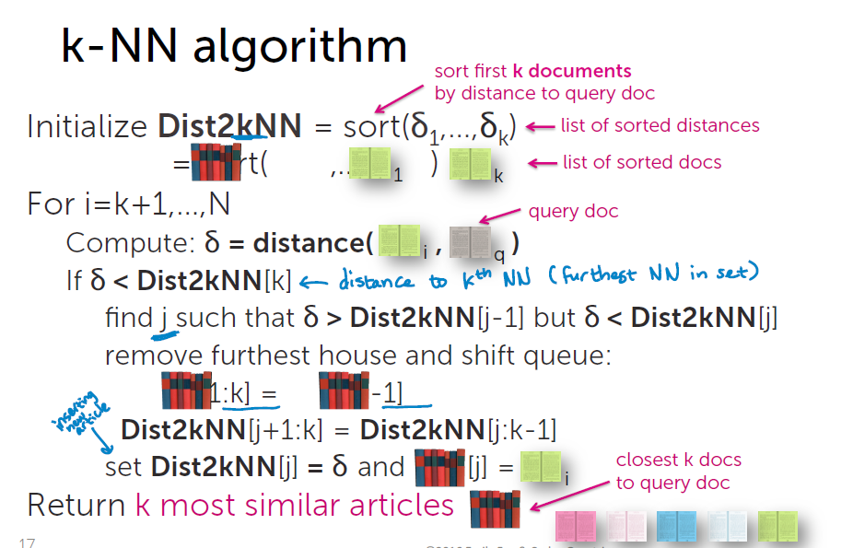

Slide 20
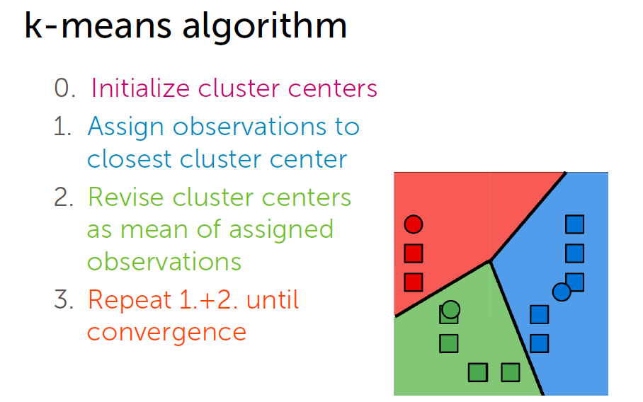

Slide 21
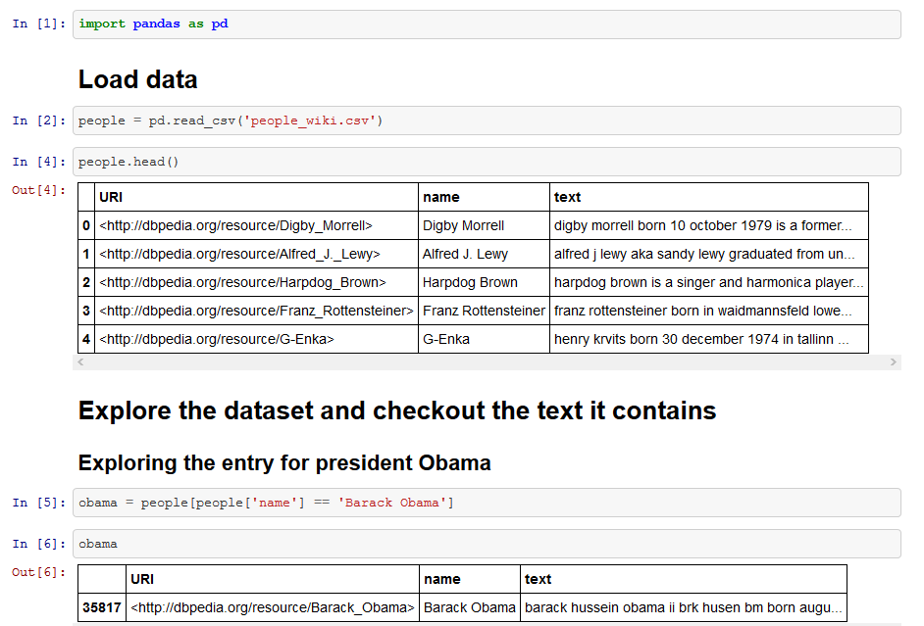

Slide 22
Recommenders
Netflix movie recommendations based on user ratings
Song recommender based on user listen count
Facebook fiend recommender
Popularity based: not personalized
Classification based: features may not be available
Co-occurrence based: who bought this also bought…
pip install scikit-surprise (in your docker container)

Slide 23
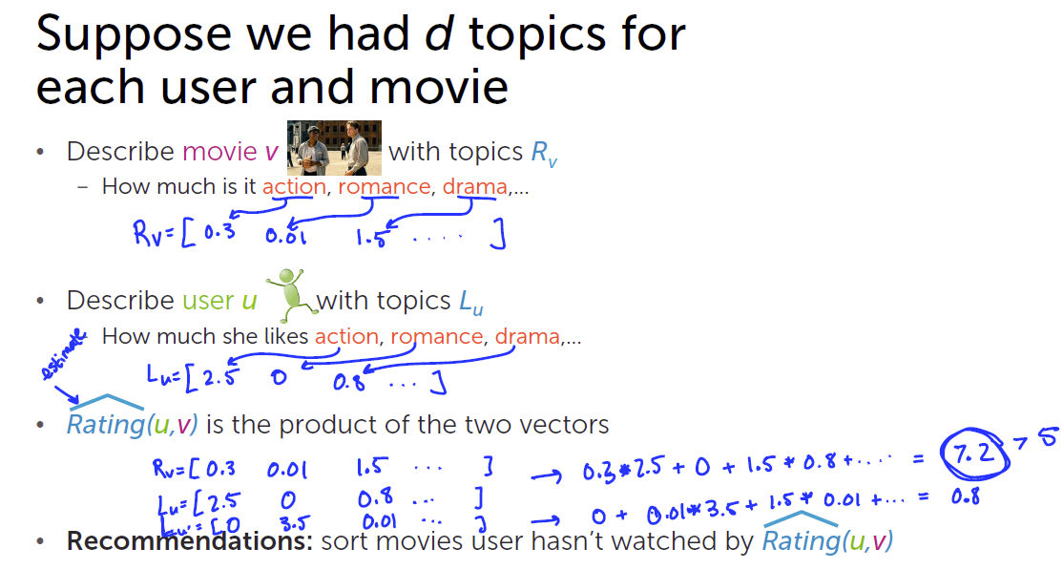

Slide 24
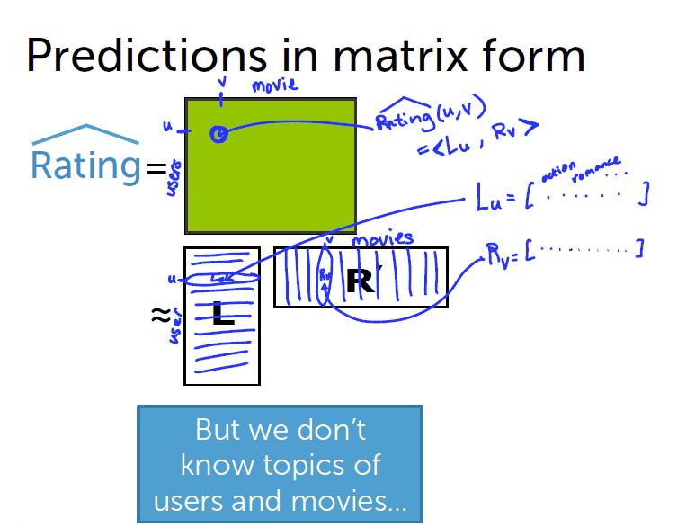

Slide 25
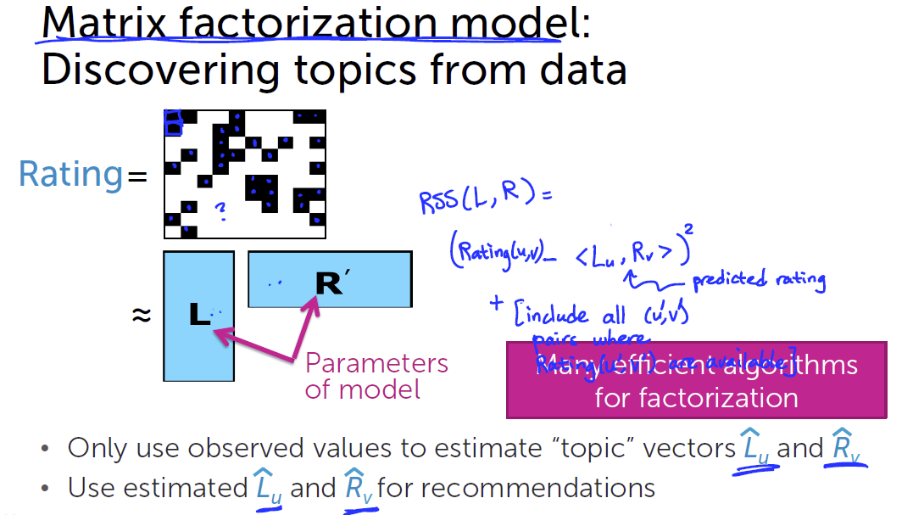

Slide 26
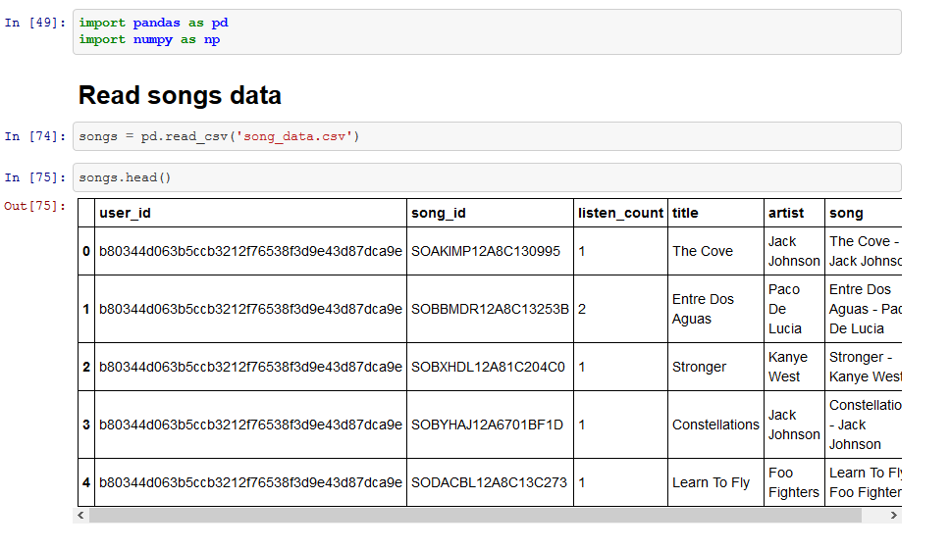

Slide 27
Deep Learning and Neural Networks
Neural networks
Image recognition
Deep features and transfer learning

Slide 28
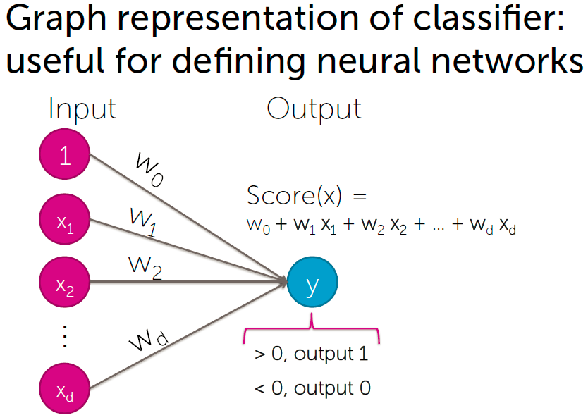

Slide 29
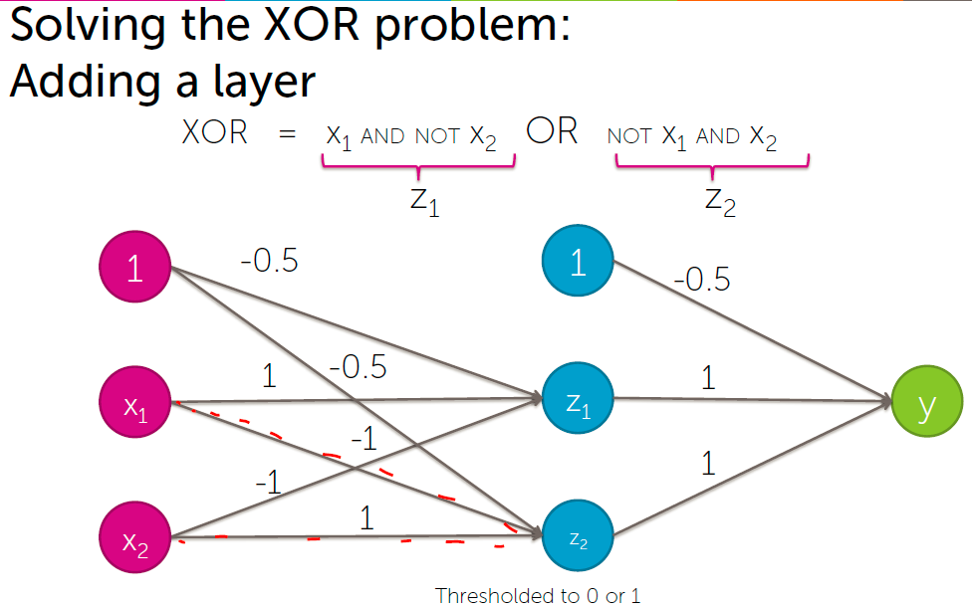

Slide 30
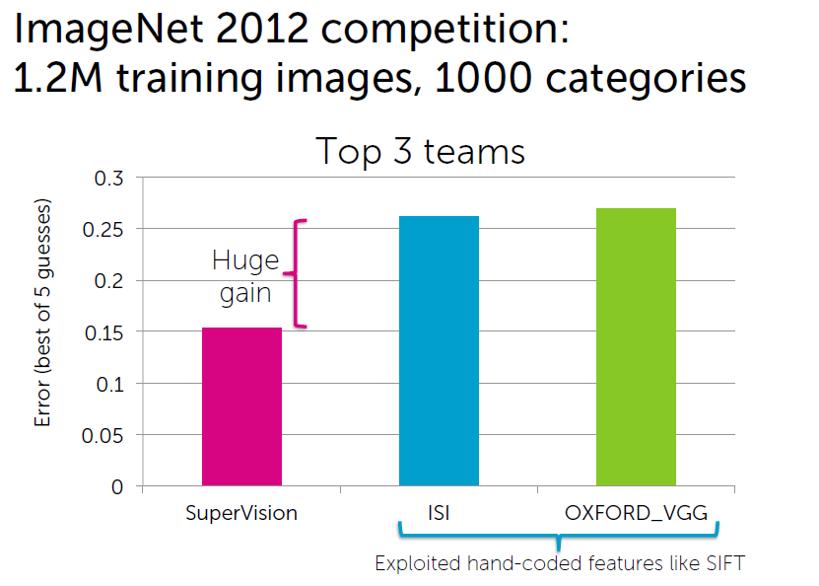

Slide 31
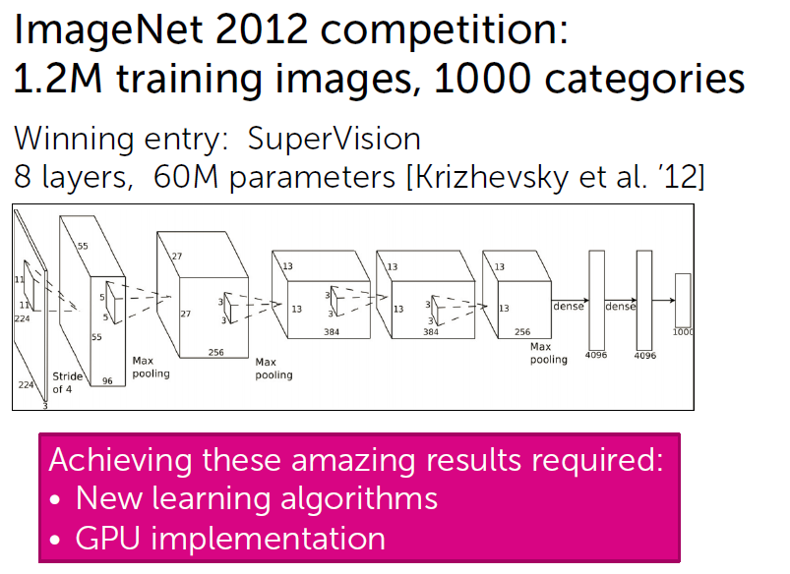

Slide 32
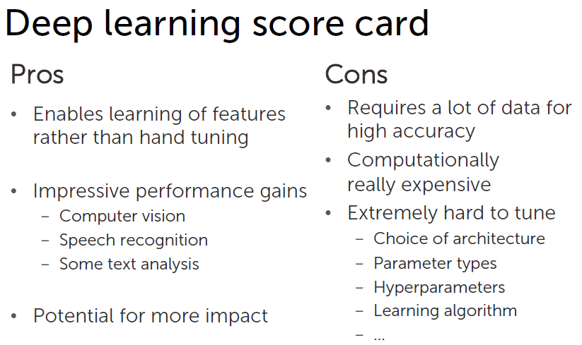

Slide 33
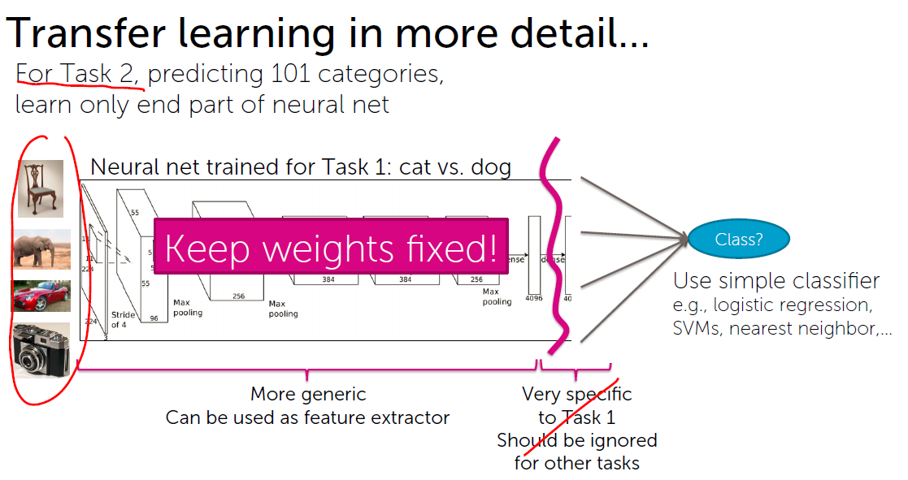

Slide 34
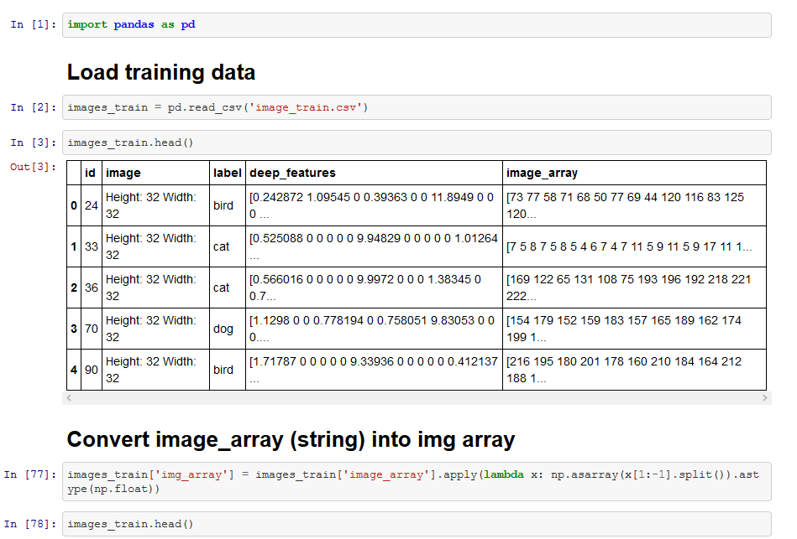

Slide 35
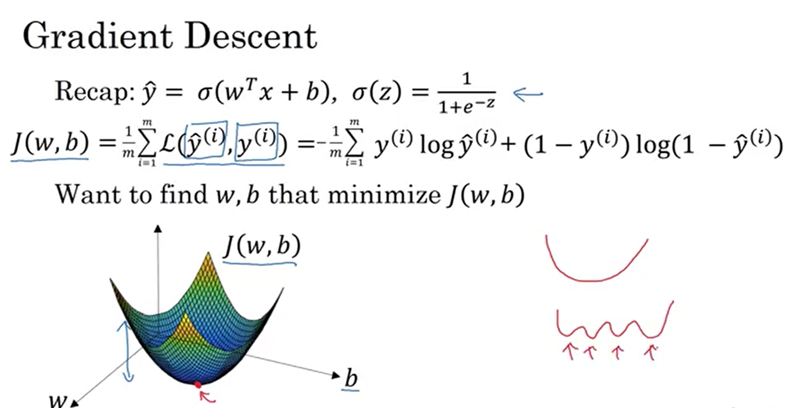

Slide 36
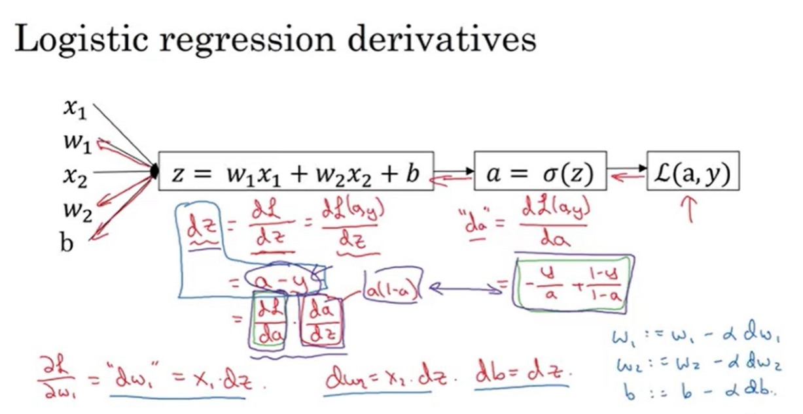

Slide 37
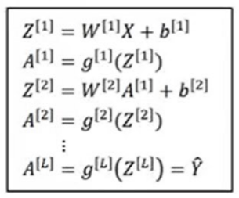
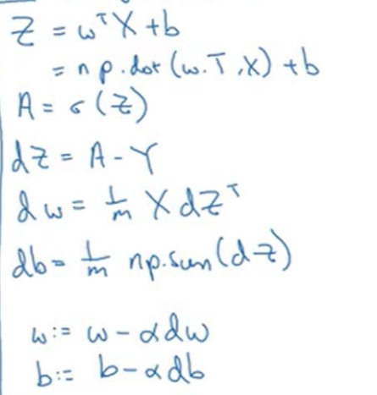
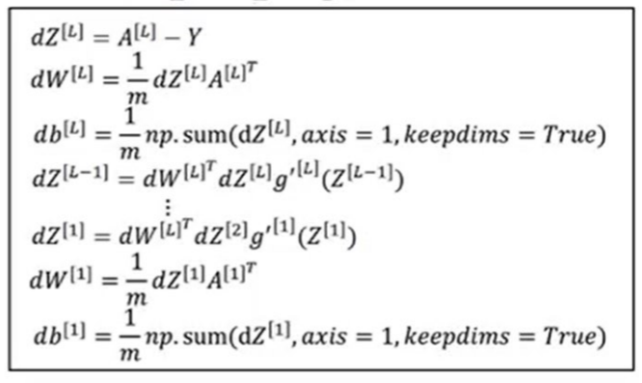

Slide 38
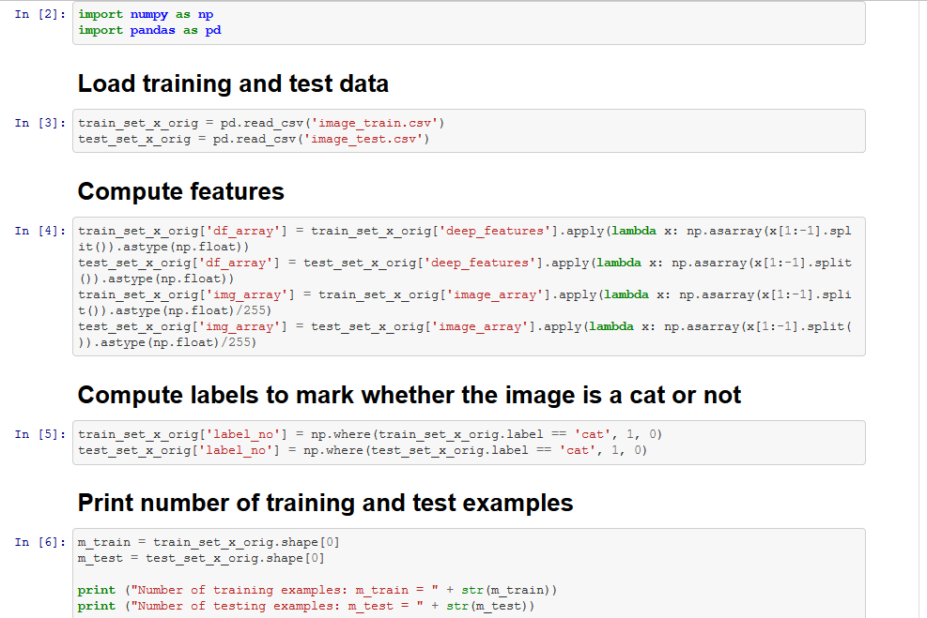

Slide 39
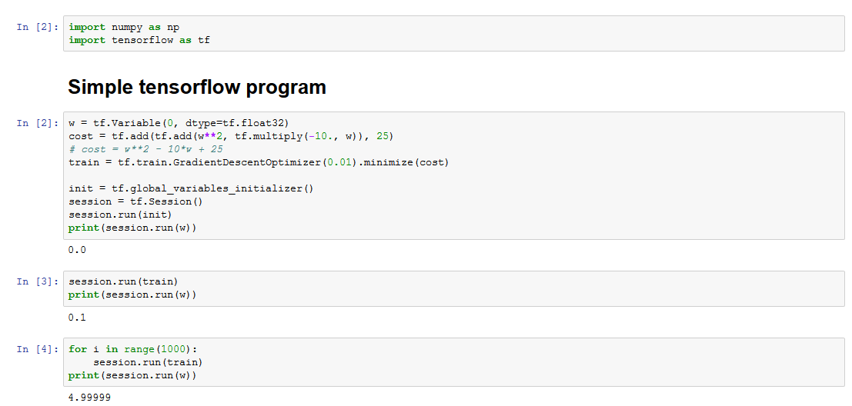
Tensorflow

Slide 40
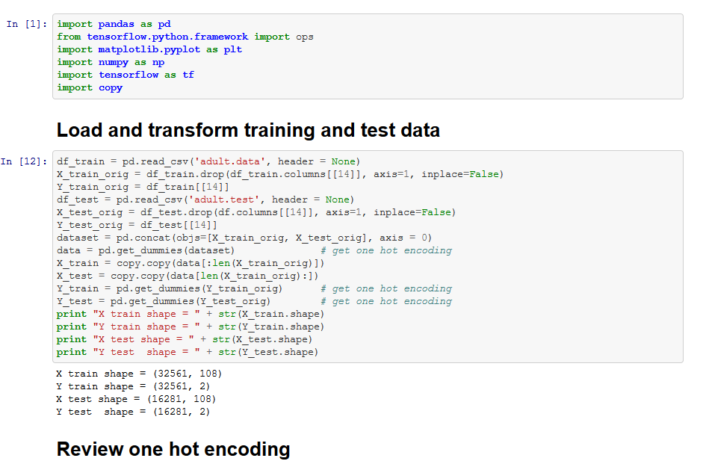
Building Neural Network from scratch using tensorflow

Slide 41
Challenges
Model selection
Feature engineering
Scaling
Data
Model
Special architectures
Parallel processing
GPUs

Slide 42
Next steps – Online courses
Coursera
Machine learning specialization
Machine learning by Andrew Ng, Stanford
Deep learning specialization
Udemy
Machine Learning A to Z
Deep Learning A to Z
Udacity
Machine Learning Engineer
Deep Learning Foundation Nanodegree Program

Slide 43
Next steps - contd
Online competitions
kaggle
Online datasets to play with
https://www.kaggle.com/datasets
http://mldata.org/repository/data/
http://archive.ics.uci.edu/ml/index.php
http://deeplearning.net/datasets/
https://deeplearning4j.org/opendata
https://catalog.data.gov/dataset
Formulate your own problem, gather data, model, evaluate and keep refining it further

Slide 44
Q&A

